Slide 1
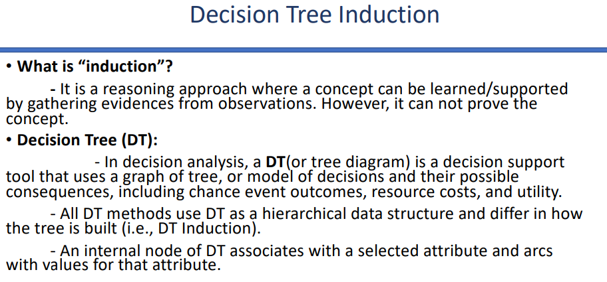

Root Node: The starting node that has zero incoming arcs and zero or more outgoing arcs.
Internal Node: A node that represents a selected attribute ($A_i$) from the data schema.
Arc: A connection labeled with a specific attribute value (predicate condition) belonging to the parent node.
Leaf Node: A terminal node labeled with a specific class ($C_j$) of the target concept.
A decision tree is a decision support tool that uses a tree- like graph or model to represent decisions and their potential consequences.

Slide 2
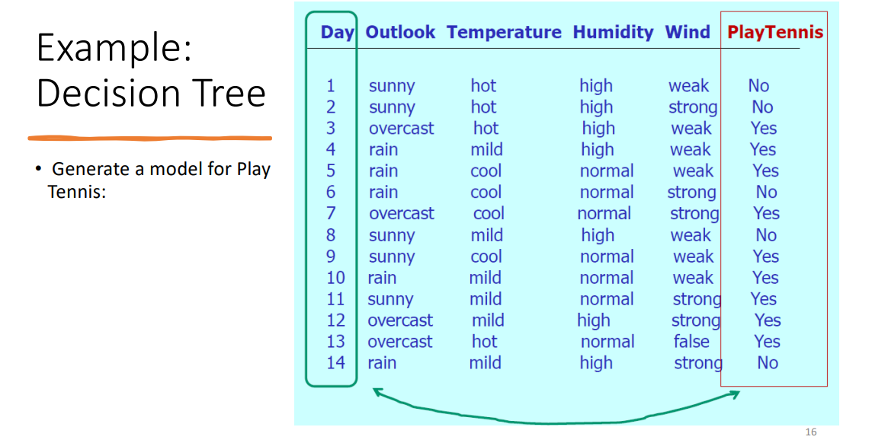

Slide 3
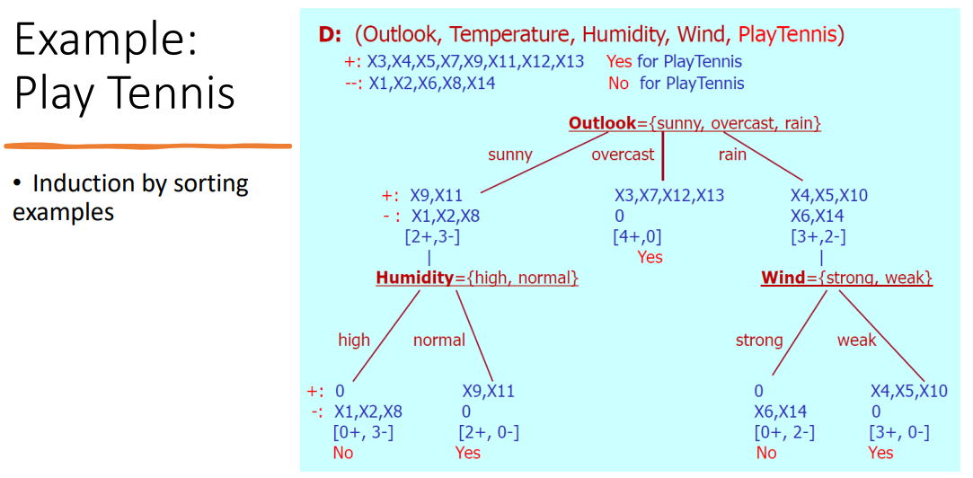

Slide 4
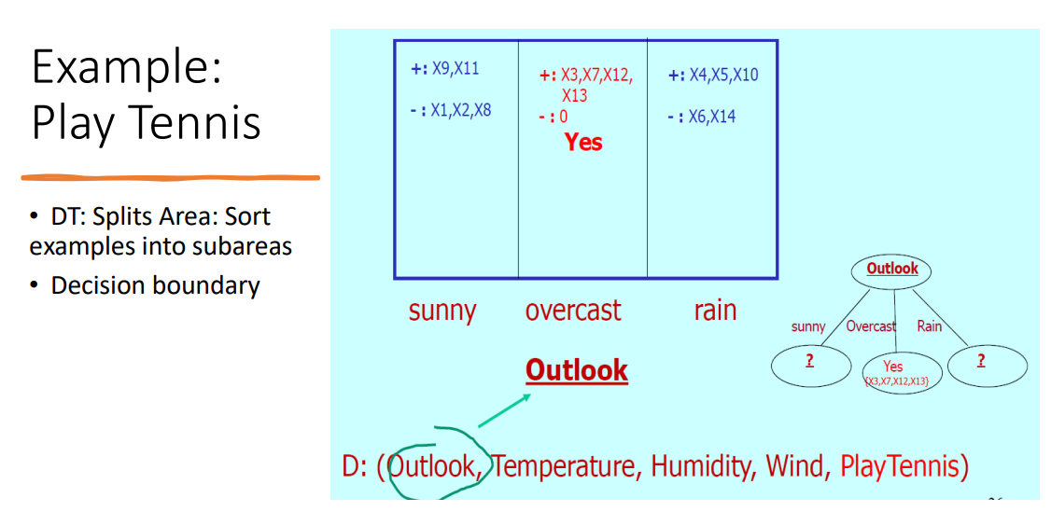

Slide 5
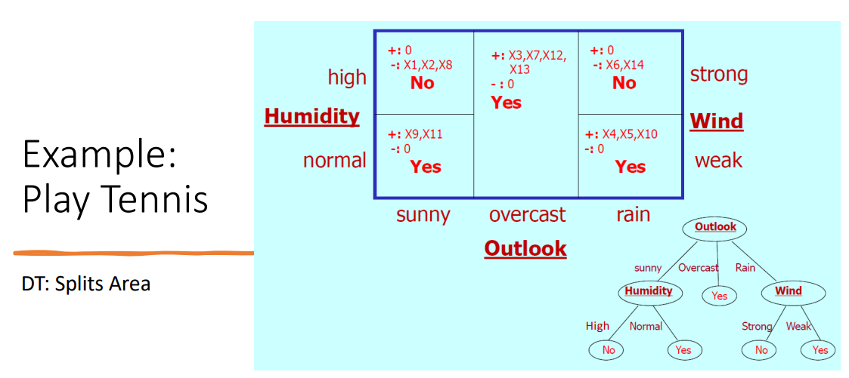

Slide 6
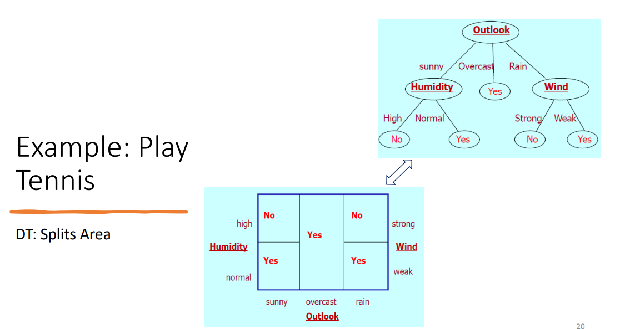


Slide 7
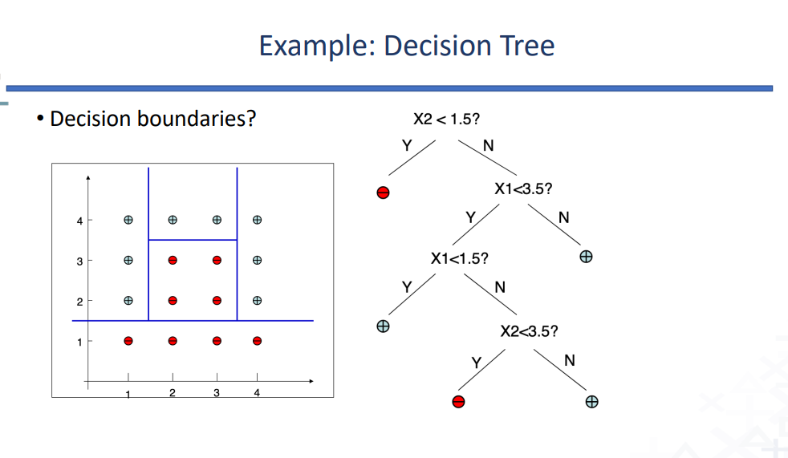
X2
X1

Slide 8
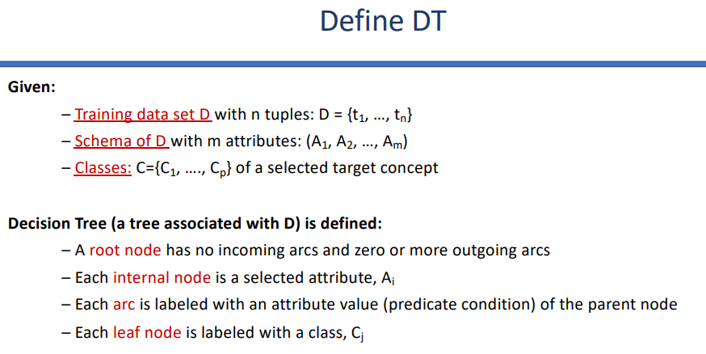

Slide 9
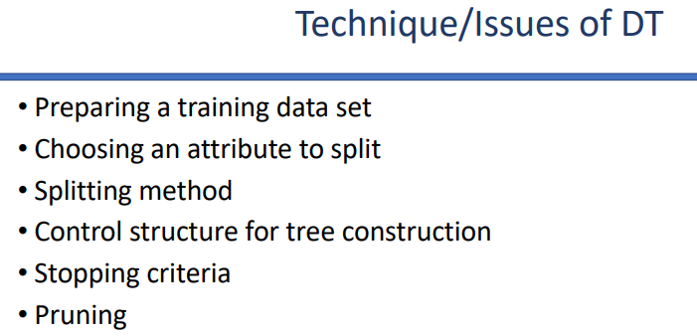


Slide 10
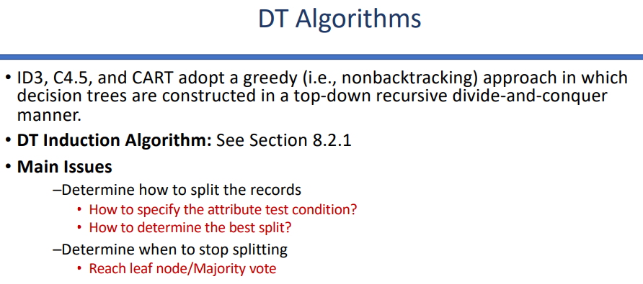


(how to split attribute values?)
(how to determine best attribute?)

Slide 11
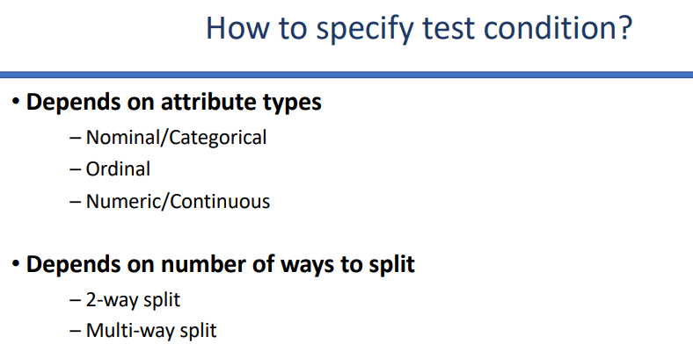
Attribute Splitting: Methods for splitting depend on attribute types, such as Nominal (e.g., CarType), Ordinal, or Continuous (e.g., Taxable Income).
(e.g. Gender: Male, Female, Other)
(e.g. Income level: Low Income, Middle Income, High Income)

Slide 12
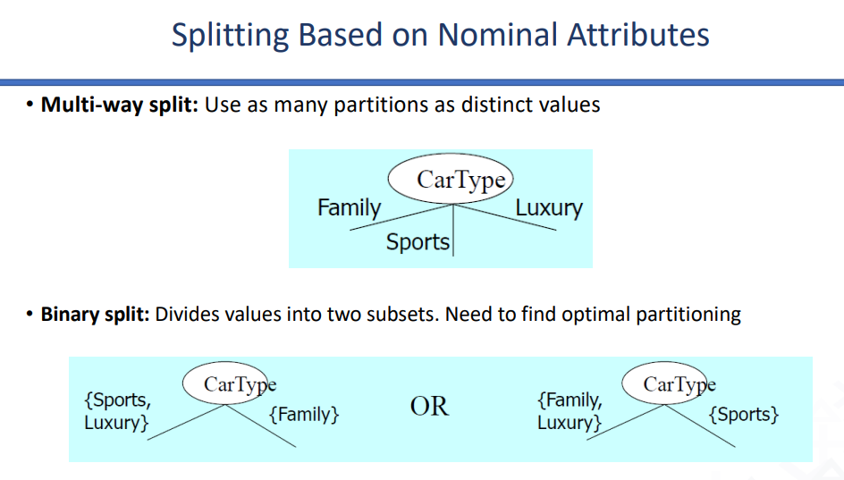



Slide 13
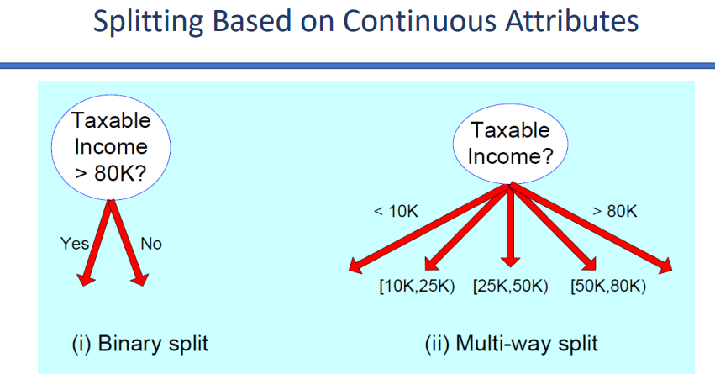

Slide 14
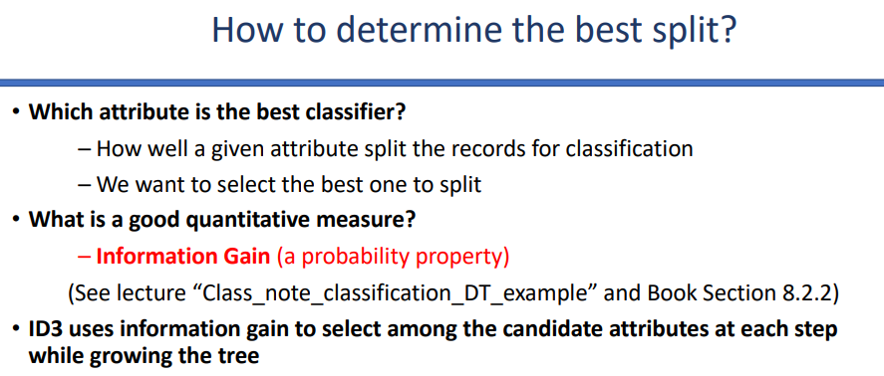



Slide 15
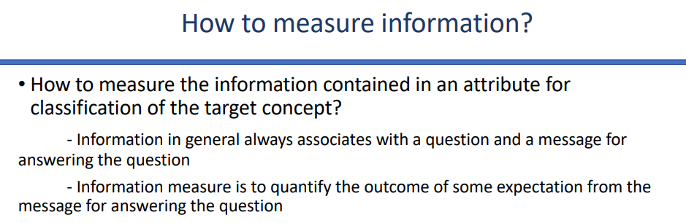


Slide 16
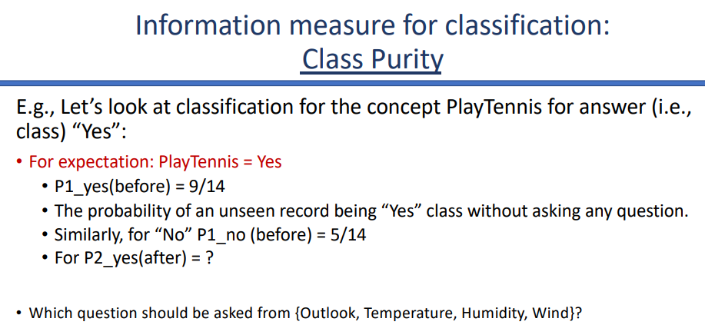

Slide 17
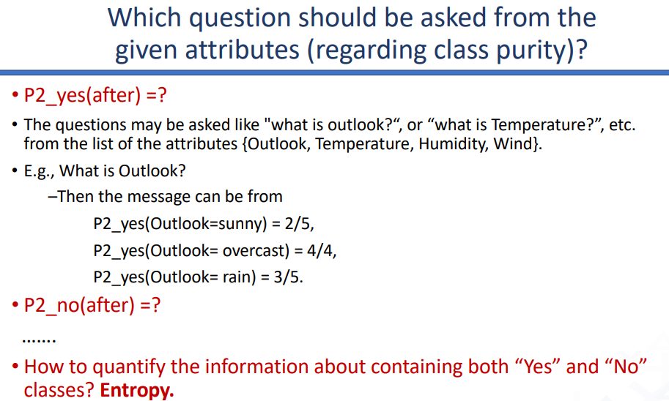

Slide 18
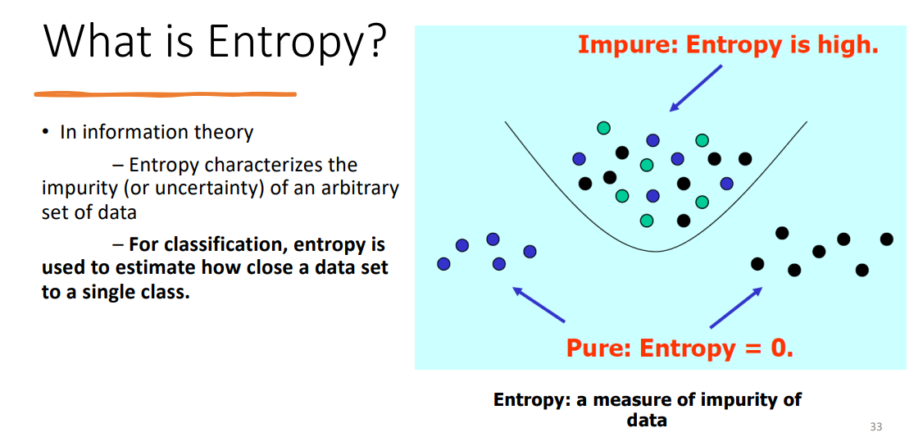
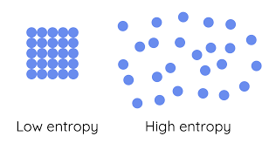



Entropy is a metric to measure the impurity in a given attribute. It is the degree of randomness in data.

Slide 19
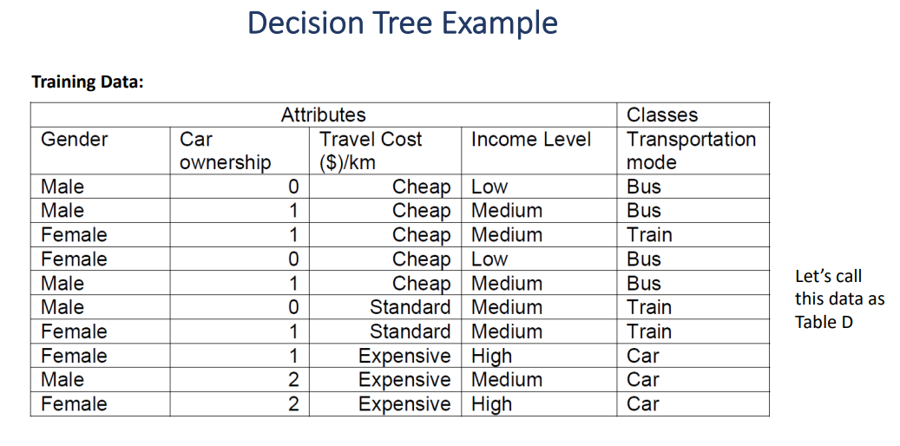

Slide 20
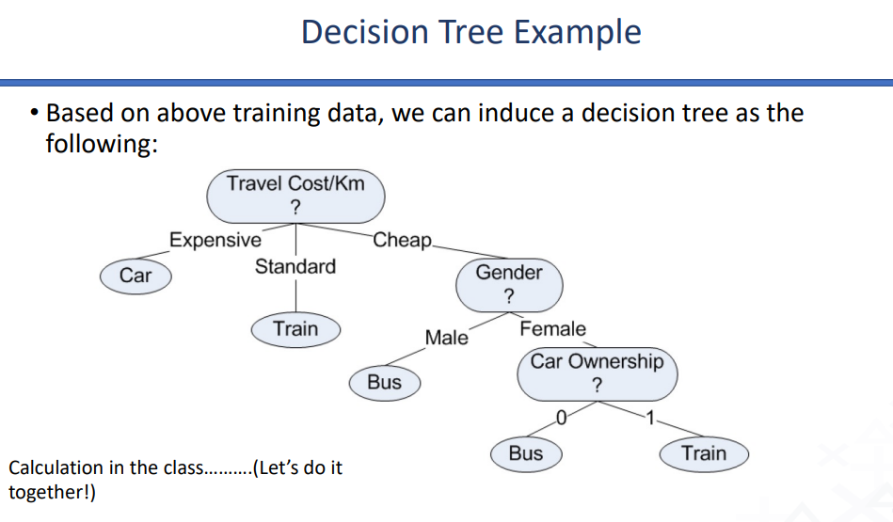

Slide 21
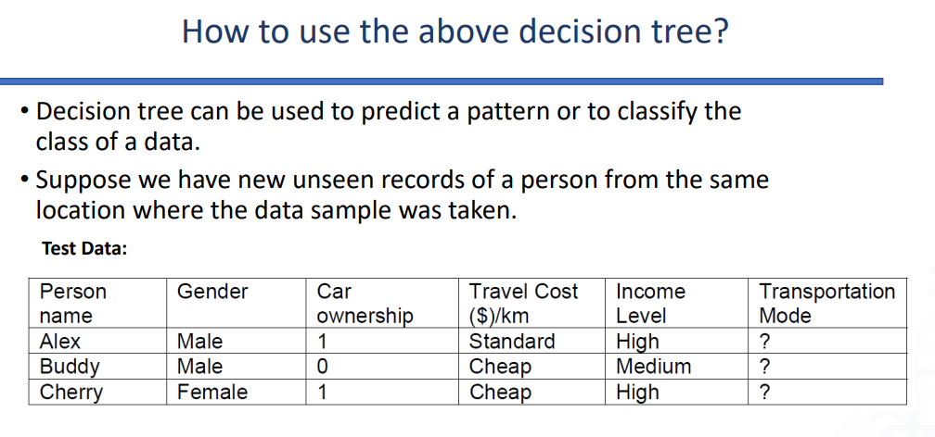

Slide 22
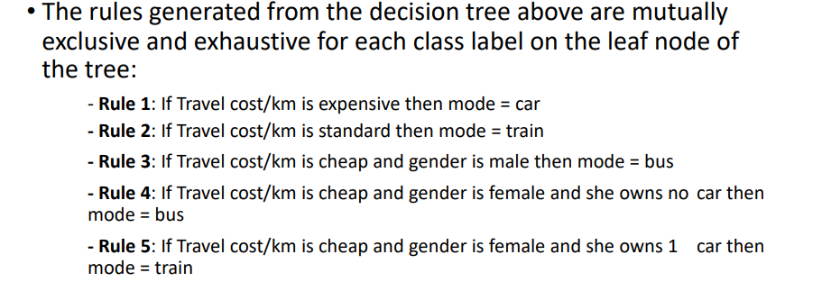

Slide 23
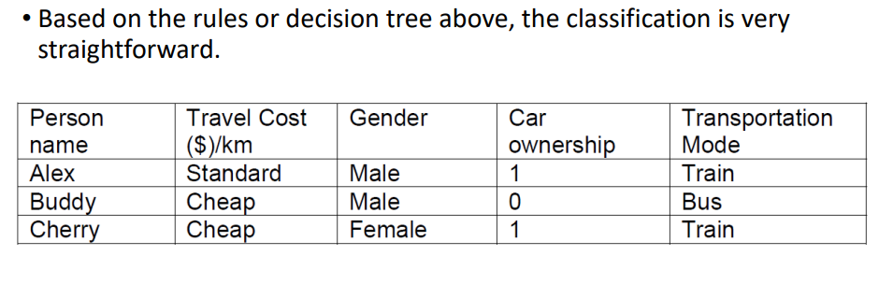

Slide 24
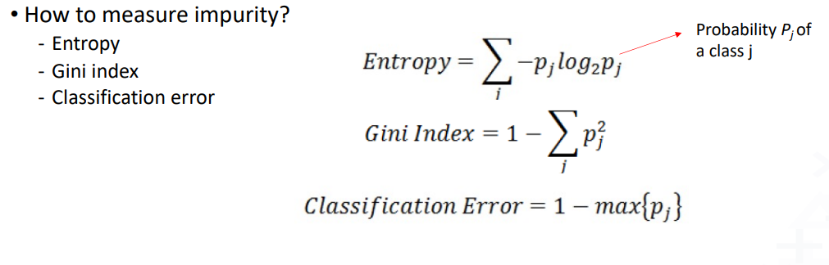


Slide 25
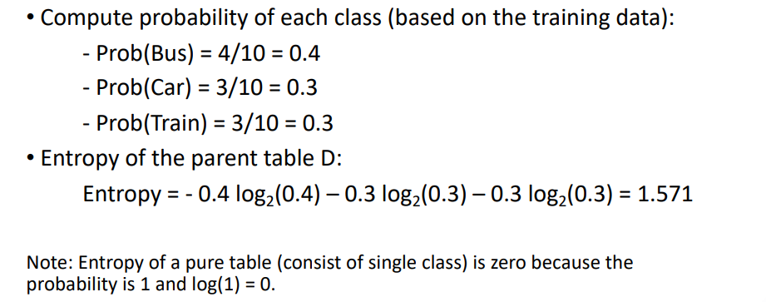

Slide 26
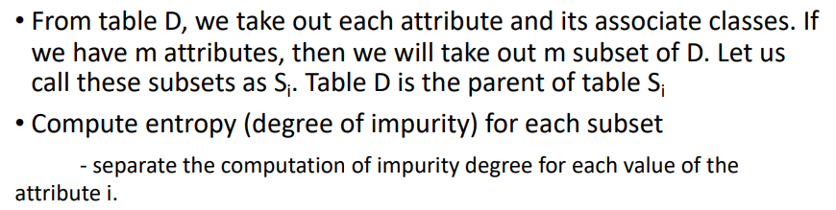

Slide 27
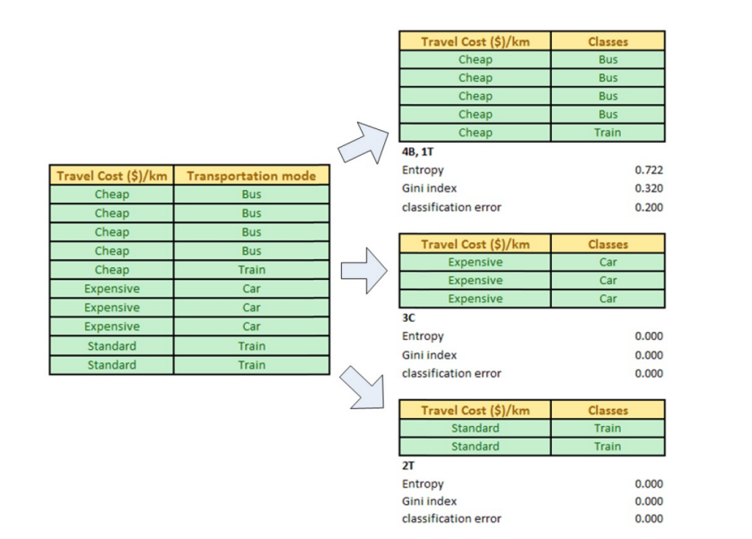

Slide 28
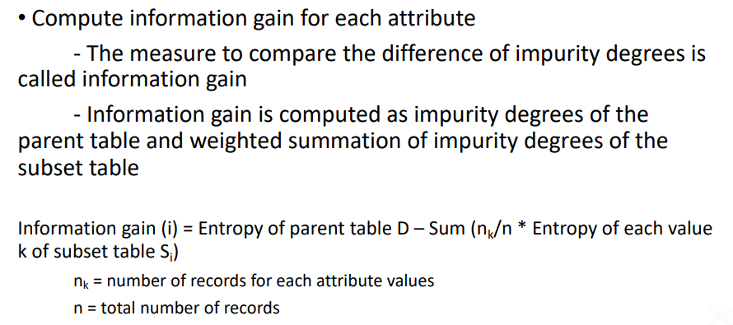




Slide 29
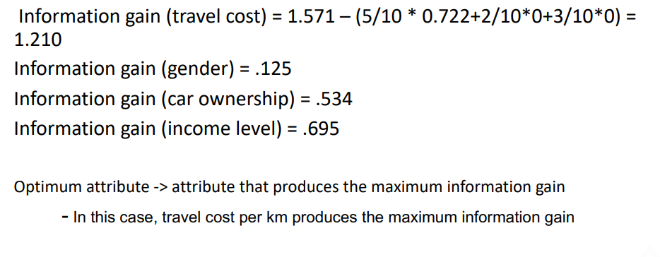
Attributes that divide the dataset into more homogeneous subsets (pure classes) yield higher information gain.

Slide 30
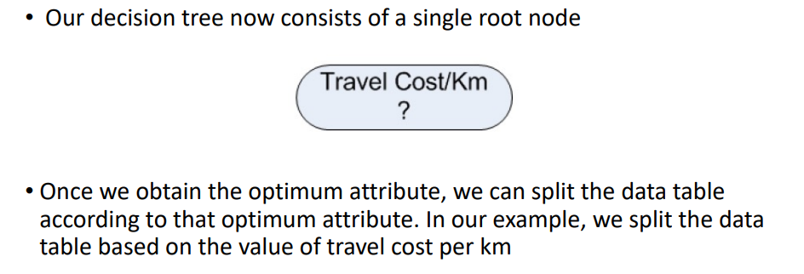

Slide 31
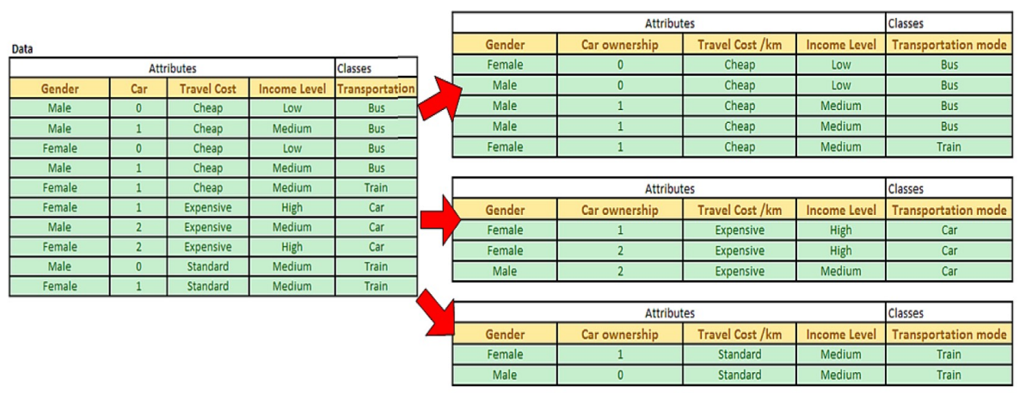

Slide 32
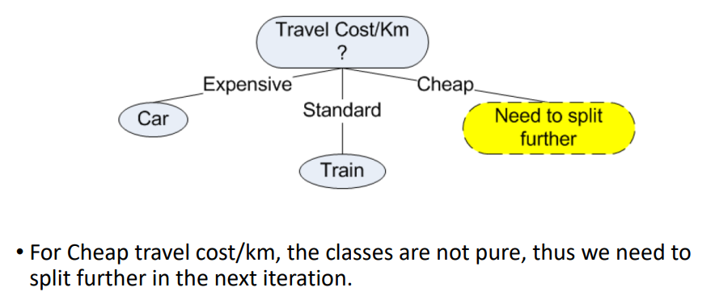

Slide 33
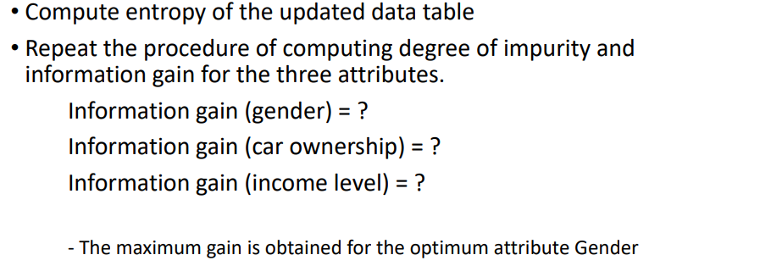

Slide 34
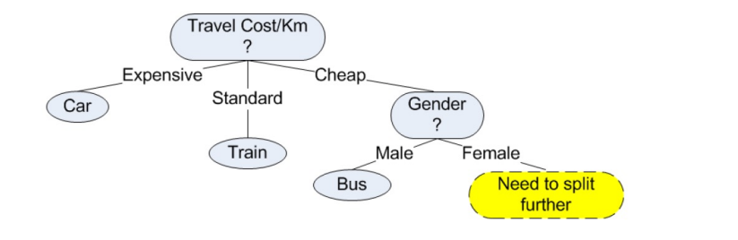

Slide 35
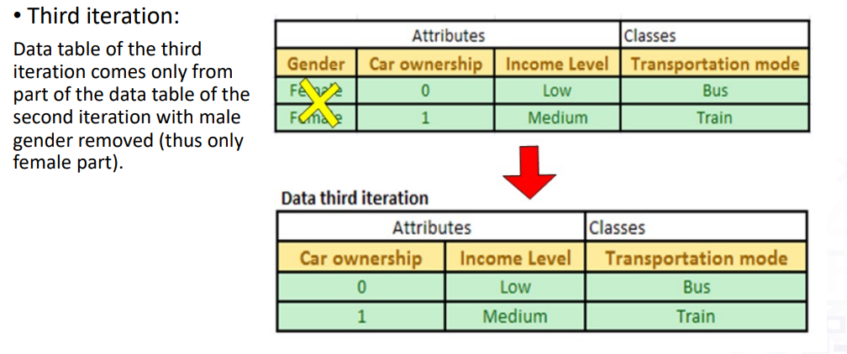

Slide 36
